Slide 1
Test Driven Development
What is it and why should I use it?

Slide 2






Richard Fennell
Chief Technology Officer (CTO)
MVP (Developer Technologies)
@RichardFennell

Slide 3
Testing Pyramid
Manual
Scripted Manual Tests
Exploratory Testing
Functional/System
L3 - End to end functional test
Testing in production
Automated UX tests
Integration/Function
L2 – using deployed system with maybe some mocking
L1 – as L0 but allows SQL connection
Unit
L0 – no dependencies & fast
The L* format is Microsoft’s https://devblogs.microsoft.com/bharry/testing-in-a-cloud-delivery-cadence/
Notes:
The L* format is Microsoft’s
https://devblogs.microsoft.com/bharry/testing-in-a-cloud-delivery-cadence/

Slide 4
Test Principles
Tests should be written at the lowest level possible
Tests written once, run anywhere including production system
Product is designed for testability
Test code is product code, only reliable tests survive
Testing infrastructure is a shared Service
Test ownership follows product ownership
Notes:
Tests should be written at the lowest level possible
This is a way of saying that we will favor tests with the fewest external dependencies over all other types of tests. We want the majority of our tests in the future to run as part of the build. Think of a parallel build system that could run unit tests for an assembly as soon as that assembly and an associated test assembly drop. We clearly cannot test every aspect of a service at this level but the principle we need to keep in mind is that we should never choose to test something with a functional test (L2/L3) where a unit test (L0) could have given us the same information.
Write once, run anywhere including production system
A large number of the tests in our test portfolio then used server Object Model. There were many reasons for this including a lack of testability in the product. This is a practice that needed to end for a few different reasons. Tests written to the server OM depend on internal knowledge and are exposed to implementation details that often do not matter from a functional test perspective. It also pins the tests to environments where the secrets and configuration information necessary to run those tests is available. That generally excludes all of our functional tests from being run against production deployments. Another way of stating this principle is that functional tests (L2/L3) should only use the public API of the product.
Product is designed for testability
One of the key opportunities we have under the combined engineering model is to do a better job of taking a complete view of what it means to deliver a quality product on a cloud cadence. Shifting the balance strongly in favor of unit testing (L0) over functional testing (L2/L3) requires us to make design and implementation choices that support testability. There are different schools of thought about exactly what constitutes well-designed and well-implemented code from a testability perspective – just as there are different perspectives on coding style. The principle to keep clearly in mind is that design for testability must become a first class part of the discussion about design and code quality throughout the team.
Test code is product code, only reliable tests survive
This speaks to the mindset that we treat test code just the same way we treat our product code. We sometimes say “config is code” to express the importance of having sound engineering practices in place to manage configuration data. Explicitly stating the principle that test code is product code is a way of saying that the quality level of this body of code is as important to shipping as our product code. We must apply the same level of care in the design and implementation of tests and our test frameworks. A code review that does not consider the test code or hold it to the same quality bar is not complete.
An unreliable test is an organizationally expensive thing to maintain. It works directly against the engineering efficiency goal by making it hard to make changes with confidence. We want to land in a place where engineers can make changes anywhere and can quickly gain a high degree of confidence that nothing has been broken. We must maintain a very high bar for reliability. We will discourage the use of UI tests. Our experience is that UI tests are generally unreliable as a class.
Testing infrastructure is a shared Service
We must lower the bar for using our test infrastructure to generate quality signals we can trust. Unit test (L0) code should live alongside product code and should be built with the product. We ultimately want those tests to run as part of the build process. Those tests must also run under the Visual Studio Team Explorer. Testing is a shared service for the entire team. It’s very well supported. It will have the same reliability as the product code.
Test ownership follows product ownership
And the last point is that the test ownership follows product ownership. In other words, the test sits right next to the product code. If you have a component that is tested at that component boundary, you do not rely on somebody else to test your component. We push the accountability to the person who is writing the code.

Slide 5

How do I created my Unit Tests?

Slide 6
The Test Driven Development Cycle
Write a failing test
Refactor
Make the test
pass
Notes:
There are 5 steps in the TDD flow:
Read, understand, and process the feature or bug request.
Translate the requirement by writing a unit test. ...
Write and implement the code that fulfills the requirement. ...
Clean up your code by refactoring.
Rinse, lather and repeat.

Slide 7
Demo TDD Kata
An empty string returns zero
A single number returns the value
Two numbers, comma delimited, returns the sum
Two numbers, newline delimited, returns the sum
Three numbers, delimited either way, returns the sum
Negative numbers throw an exception
https://osherove.com/tdd-kata-1

Slide 8
So with TDD we get…
To write the test before the code
Emergent design of architecture
Excellent test coverage
But what happens when we need systems that are not available to the developer?

Slide 9
What is Mocking
Stub
Fake
Mock
Notes:
Stub - We replace a real object with a test-specific object that feeds the desired indirect inputs into the system under test
Fake - Replace a component that the system under test (SUT) depends on with a much lighter-weight implementation
Mock - Replace an object the system under test (SUT) depends on with a test-specific object that verifies it is being used correctly by the SUT.

Slide 10





Mocking the ‘Principal of Isolation’
Production Code
Production Code
Unit Test
Unit Test
Data Access Code
Logging Code
Web Service Code
Data Access Code
Mocked
Logging Code
Mocked
Web Service Code Mocked
Mocking Layer(s)
Database
Logging Service
Web Service
Notes:
.NET examples, but available in most languages

Slide 11
Demo Mocking with Moq

Slide 12
Frameworks for common languages*
Language | Testing Framework | Mocking Framework
.NET | MSTest, xUnit, NUnit | Moq, NMock
Java | JUnit | Mockito, EasyMock
JavaScript, TypeScript, Node.JS | Jest, Mocha, Jasmine | Mocha, Jasmine
C++ | CppUnit, Google Test, Boost | CppUnit, Cmock
Python | PyTest, PyUnit | PSBoundParameters
* a far from exhaustive list

Slide 13
But what is the argument against TDD?
Pros.
Cons.
Only write code needed
Easier to maintain/refactor
High test coverage
Tests are the documentation
Not a silver bullet
Can be slow to develop
Usually needs a lot of mocking
All the team has to adopt
Tests must be maintained

Slide 14
Summary
TDD is a way to get high code coverage
High code coverage makes refactoring safer
Mocking is a key tool to enable TDD
Practice your skills with Coding Katas

Slide 15


Question?
Slides https://github.com/rfennell/Presentations

Slide 16
Richard Fennell
Chief Technology Officer (CTO)
MVP (Developer Technologies)
@RichardFennell

Slide 17



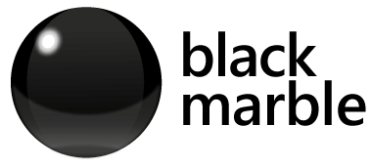


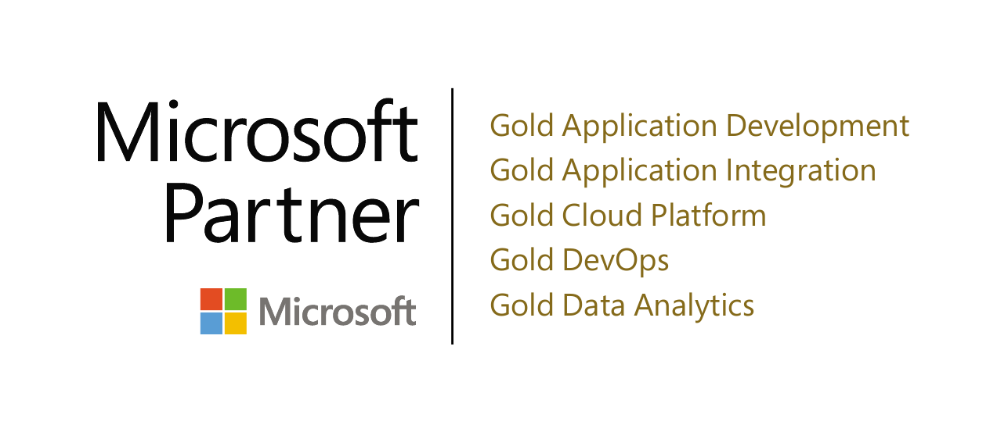







Azure Integration Services

Slide 18





blogs.blackmarble.co.uk
+44 (0)1274 300175
@blackmarble
Black Marble Ltd.
Black Marble

